Slide 1
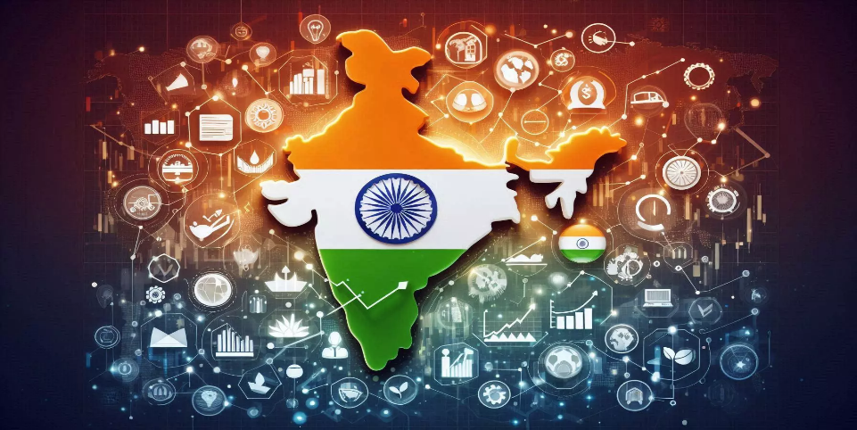
INDIA'S RESILIENCE TO SAIL THROUGH GLOBAL TURBULENCE
Presentation by Shri T. N. Manoharan, Chairman, IDBI Bank & Past President of ICAI
49th Regional Conference organized by Eastern India Regional Council of The Institute of Chartered Accountants of India | August 2024
Notes:
© Copyright PresentationGO.com – The free PowerPoint and Google Slides template library

Slide 2
Factors Behind Resilient Indian Economy
5th largest economy globally
One of the fastest growing economies
Diversified growth drivers
Strong domestic demand
Technology and innovation hub
Manifold increase in digital adoption
Large and young workforce
Improving Infrastructure
Rising Global Competitiveness
Attractive Investment Destination
Adequate forex reserves
4th largest equity market globally
Notes:
© Copyright PresentationGO.com – The free PowerPoint and Google Slides template library

Slide 3
Sound Domestic Fundamentals
Source: Economic Outlook database, Centre for Monitoring Indian Economy
Notes:
© Copyright PresentationGO.com – The free PowerPoint and Google Slides template library

Slide 4
Select Key Sectors
AUTOMOBILE
Largest manufacturer of two-wheelers and tractors
PHARMACEUTICALS
Largest vaccine producer with a 60% share globally
IT & BPM
Largest market share in global services sourcing industry at 57%
TRANSPORT
One of the world's largest rail network in terms of passenger traffic
3rd largest heavy truck manufacturer
4th largest car manufacturer
Share in global R&D - 40%
2nd highest number of USFDA approved manufacturing plants outside the USA
Largest provider of generic medicines globally
3rd largest and the fastest growing hub for technology startups
2nd largest road network of about 66.71 lakh km
3rd largest aviation market globally
6th largest maritime country
Notes:
© Copyright PresentationGO.com – The free PowerPoint and Google Slides template library

Slide 5
Select Key Sectors
TOURISM & HOSPITALITY
2nd in terms of Travel & Tourism Employment
BFSI & Fintech
TELECOM
2nd largest subscriber base of 1.09 Bn
Set to become the 3rd largest domestic banking sector by 2050
6th in terms of Travel & Tourism total contribution to GDP
39th on the World Economic Forum Travel & Tourism Development Index
More than 950 Mn active internet users
60th rank as per Network Readiness Index 2023
MEDIA & ENTERTAINMENT (M&E)
2nd largest market by app downloads
2nd largest social media market by the number of users
M&E industry expected to reach US$100 Bn by 2030
9th largest Life Insurance market & 14th largest Non-Life Insurance market
3rd largest fintech ecosystem
Digital lending market - US$270 Bn
Notes:
© Copyright PresentationGO.com – The free PowerPoint and Google Slides template library

Slide 6
Major Structural Reforms
JAM Trinity
GST
IBC
Banking Sector Reforms
MSME Sector Reforms
National Infrastructure Pipeline (NIP)
National Monetisation Pipeline (NMP)
RERA, Act 2016
Notes:
© Copyright PresentationGO.com – The free PowerPoint and Google Slides template library

Slide 7
Key Indicators
JAM Trinity*
IBC – Corporate Insolvency Resolution Process#
Aadhaar Generated – 140.22 crore
Active wireless subscribers – 105.97 crore
Beneficiaries under PMJDY - 52.99 crore
Admitted Cases
7813
Closure*
5840
Ongoing Cases
1973
* - PMJDY Beneficiaries as on 31/07/2024, Aadhaar Enrolment as on 14/08/2024, Active wireless subscribers in May 31, 2024
# - As at end-Jun 2024; * - Withdrawn/ Closed/ Resolved/ Liquidated

Slide 8
Key Indicators
Start-up Landscape
130,000+ recognized startups
Spread over 669 districts from 36 States & UTs
50% have base in Tier 2 - Tier 3 cities
Home to 108 unicorns with a total valuation of $ 340.80 Bn
Tourism & Hospitality
6th in terms of Travel & Tourism total contribution to GDP, WTTC (2021)
2nd in terms of Travel & Tourism Employment, WTTC (2021)
39th on the World Economic Forum Travel & Tourism Development Index (2024)
9.24 Mn Foreign Tourist Arrivals (2023)
1.73 Bn Domestic Tourist Visits to all States/UTs (2022)

Slide 9
Tax Collection
Post GST
* - Combined Tax Revenue of Central and State Governments
# - Non-Individuals include Hindu Undivided Family (HUF), Firms, Association of Persons/ Body of Individuals (AOP/BOI), Companies and Others

Slide 10
Key Government Schemes
Atal Pension Yojana
Atmanirbhar Bharat Abhiyaan
Digital India
Jan Dhan Yojana
Jeevan Jyoti Bima Yojana
Mudra Yojana
Stand Up India
Skill India
PM Gati Shakti
Production Linked Incentive (PLI) Scheme
Notes:
© Copyright PresentationGO.com – The free PowerPoint and Google Slides template library

Slide 11
A Growth Strategy For New India
The Union Budget 2024-25, weaved around the narrative of “Viksit Bharat @ 2047”, focused on employment, skilling, MSMEs and the middle class through the following 9 priorities:
Productivity and Resilience in Agriculture
Employment & Skilling
Inclusive Human Resource Development and Social Justice
Manufacturing & Services
Urban Development
Energy Security
Infrastructure
Innovation, Research & Development
Next Generation Reforms
Notes:
© Copyright PresentationGO.com – The free PowerPoint and Google Slides template library

Slide 12
Viksit Bharat @ 2047
Viksit Bharat 2047 is the vision to transform India into a developed nation by 2047 - the 100th year of independence.
The four pillars of Viksit Bharat are Yuva (Youth), Garib (Poor), Mahilayen (Women) and Annadata (Farmers).
The vision of Viksit Bharat is that of a prosperous Bharat in harmony with modern infrastructure and nature and giving opportunities for all citizens of all regions to reach their potential.
Different aspects of Viksit Bharat are:
Resilient Economy
Environmental Sustainability
Inclusive & Harmonious society
Agile & Robust Governance
Notes:
© Copyright PresentationGO.com – The free PowerPoint and Google Slides template library

Slide 13
Risks to India’s Economic Outlook
Global Economic Slowdown
Inflation
Geopolitical Tensions
Climate Change
Evolving Policy & Regulatory Norms
Technological Disruption
Energy Import Dependency
Labour Market Challenges
Capital Outflows
Notes:
© Copyright PresentationGO.com – The free PowerPoint and Google Slides template library

Slide 14
Countering the Risks
Improving Agricultural Productivity
Strengthening Supply Chains for Essential Goods
Enhancing Domestic Manufacturing Capabilities
Investing In Infrastructure
Investing In Sustainable Practices
Effective Disaster Management Systems
Stable & Predictable Policy Environment
Investing In Digital Infrastructure
Supporting Innovation & Startups
Deepening Domestic Financial Markets
Enhancing Skill Development
Promote Entrepreneurship
Notes:
© Copyright PresentationGO.com – The free PowerPoint and Google Slides template library

Slide 15
Role of CAs in Building Resilient India
Credible Financial Reporting
Compliance with Statutory & Regulatory Norms
Tax Advisory
Virtual CFO & Risk Assessment
Assurance Function
Strategic Planning
M&A and Corporate Restructuring
Financial Management Advisory
Facilitate Access to Finance
Policy Formulation
Corporate Governance & Ethics
Notes:
© Copyright PresentationGO.com – The free PowerPoint and Google Slides template library

Slide 16
Comparison of Key Socio-Economic Indicators
COMPARATIVE POSITION OF KEY ECONOMIES
 | GDP Growth (%) (2023) | GDP per capita (current US$ K) 2023 | GDP PC Rank | GDS (% of GDP) (2023) | GDS Rank | GCF (% of GDP) (2023) | GCF Rank | Happiness Index (2024) | Human Development Index (2022) | Global Health Security Index (2021) | Ease of Doing Business (2020) | Global Innovation Index (2023) | World Competitiveness Index (2024)
USA | 2.54 | 82 | 6 | 18.11 | 96 | 21.88 | 99 | 23 | 20 | 1 | 6 | 3 | 12
China | 5.20 | 13 | 71 | 46.56 | 11 | 43.15 | 4 | 60 | 75 | 52 | 31 | 12 | 14
Japan | 1.92 | 34 | 32 | 22.83 | 67 | 26.59 | 53 | 51 | 24 | 18 | 29 | 13 | 38
Germany | -0.30 | 53 | 18 | 27 | 50 | 25.03 | 71 | 24 | 7 | 5 | 22 | 8 | 24
India | 7.58 | 2 | 141 | 28.36 | 46 | 33.02 | 25 | 126 | 134 | 66 | 63 | 40 | 39
UK | 0.10 | 49 | 21 | 17.14 | 99 | 18.6 | 125 | 20 | 15 | 7 | 8 | 4 | 28
France | 0.70 | 44 | 24 | 22.6 | 71 | 26.48 | 56 | 27 | 28 | 14 | 32 | 11 | 31
Italy | 0.92 | 38 | 26 | 21.46 | 78 | 23.09 | 88 | 41 | 30 | 41 | 58 | 26 | 42
Canada | 1.07 | 53 | 16 | 25.52 | 53 | 25.36 | 68 | 15 | 18 | 4 | 23 | 15 | 19
S. Korea | 1.36 | 33 | 34 | 33.15 | 28 | 33.18 | 24 | 52 | 19 | 9 | 5 | 10 | 20
Source: World Development Indicators (WDI) database, Human Development Report 2023-24, World Happiness Report 2023, 2021 Global Health Security (GHS) Index Report, Doing Business Report 2020, Global Innovation Index 2023 (GII), IMD World Competitiveness 2024

Slide 17
Growing Global Prominence
“India has been a key growth engine for the world, contributing 16% to the global growth in 2023.”
World Economic Forum
“India will emerge as the world’s third-largest economy by 2027, surpassing Japan and Germany, with GDP exceeding US$5 trillion.”
International Monetary Fund (IMF)
“India’s Growth to Remain Resilient Despite Global Challenges.”
World Bank
“India will emerge as the largest economic superpower by the end of the century.”
Centre for Economics and Business Research (CEBR)
“India will likely account for 18 per cent of world growth by 2028.”
International Monetary Fund (IMF)

Slide 18
Thank You!
T. N. Manoharan
Notes:
© Copyright PresentationGO.com – The free PowerPoint and Google Slides template library

